Slide 1
Simulation and Modeling
CSE4131_CSE4132

Slide 2
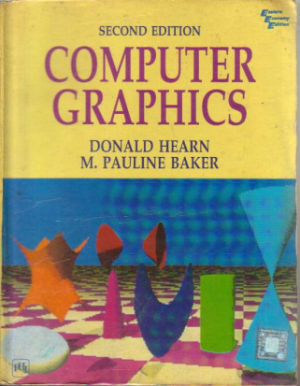
Reference Book
Computer Graphics (2nd Edition)
D. HEARN
M. P. BAKER

Slide 3
SPLINE
Spline
Interpolation
Cubic Spline Interpolation Method
Natural Cubic Splines
Hermit Spline
Cardinal Splines
Kochanek-Bartels Splines
Approximation
Bezier curves and surfaces
B-spline curves and surfaces
Beta-Splines
Rational Splines

Slide 4
SPLINE
Spline
Interpolation
Cubic Spline Interpolation Method
Natural Cubic Splines
Hermit Spline
Cardinal Splines
Kochanek-Bartels Splines
Approximation
Bezier curves and surfaces
B-spline curves and surfaces
Beta-Splines
Rational Splines

Slide 5

Bezier curves and surfaces
Last class ⇨ Bezier Spline + cubic Bezier Spline
Now we need to know about Bezier Surface
Bezier Surface
Two sets of orthogonal Bezier curves can be used to design an object surface by specifying by an input mesh of control points.
The parametric vector function for the Bezier surface is formed as the Cartesian product of Bezier blending functions:
Eq. 10.53
with p_{j,k} specifying the location of the (m + 1) by (n + I ) control points.

Slide 6
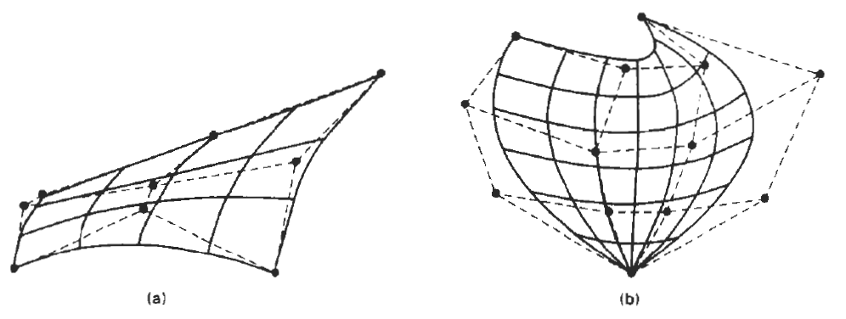
Bezier Surface
Figure 10-39 illustrates two Bezier surface plots.
The control points are connected by dashed lines, and
the solid lines show curves of constant u and constant v.
Each curve of constant u is plotted by varying v over the interval from 0 to 1, with u fixed at one of the values in this unit interval.
Curves of constant v are plotted similarly

Slide 7
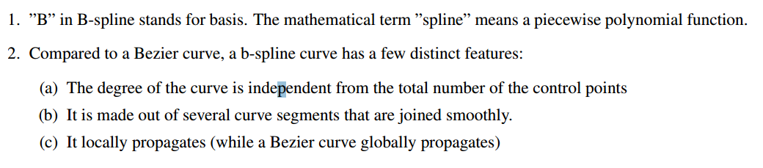
B- Spline Curves

Slide 8
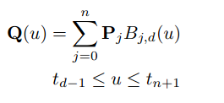
B- Spline Curves
A b-spline curve is mathematically defined as:
(d-1) is the degree of the polynomial, for example: d= 2 is linear,
d= 3 is quadratic,
d= 4 is cubic, etc. The value of n must be larger or equal to d. t_{j} is a knot value.
* d is the number of the control points that control a segment
Control points
Total points=n+1

Slide 9
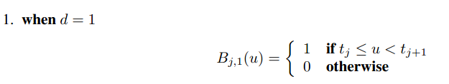
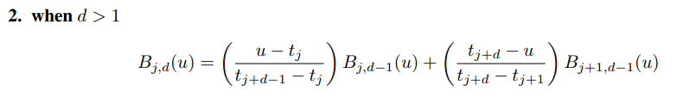
B- Spline’s Basis Functions
There exist two mathematical definition of B-Spline blending function:
New terms: Knot Vector t=(t₀, t₁, t₂, t₃,…)

Slide 10



Knot Vector
The number of the knot values (or the size of the knot vector) is determine by:

Slide 11
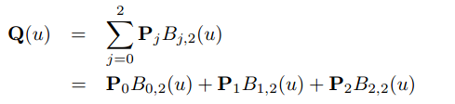
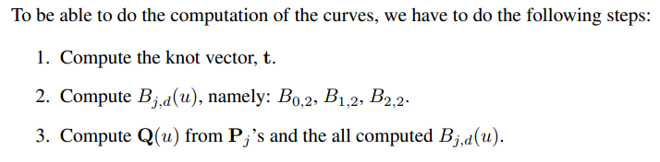
Linear Uniform B-spline Curves
In b-spline, linear means that d= 2. Suppose we have 3 control points, implying n= 2.
Hence, we can write the linear uniform b-spline curves as:

Slide 12


Computing the knot vector
By considering
n= 2 and d= 2, we can have m= n + d + 1 = 5
Since it is a uniform b-spline curve and we can assume k= 1, then:

Slide 13

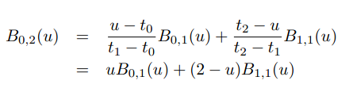
Computing B_{j,d}(u)
Here, j=0 and d=2

Slide 14
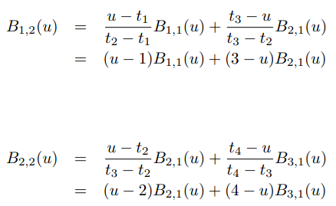
Computing B_{j,d}(u)
we need the definition of B_{0,1}(u); B_{1,1}(u); B_{2,1}(u), and B_{3,1}(u)

Slide 15





case j=0
case j=1
case j=2
case j=3

Slide 16

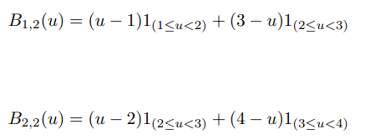
Similarly:

Slide 17
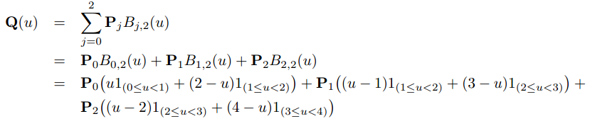
B- Spline
Finally

Slide 18

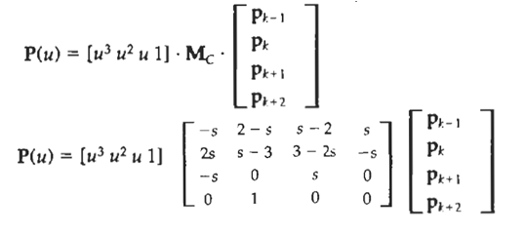
CONVERSION BETWEEN SPLINE REPRESENTATIONS
Hermite Spline:
Cardinal Splines:

Slide 19

CONVERSION BETWEEN SPLINE REPRESENTATIONS
Sometimes it is desirable to be able to switch from one spline representation to another.
Suppose we have a spline description of an object that can be expressed with the following matrix product:
where
M_{spline1} is the matrix characterizing the spline representation, and
M_{geom1} the column matrix of geometric constraints (for example, control-point coordinates).

Slide 20


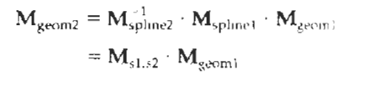

CONVERSION BETWEEN SPLINE REPRESENTATIONS
We are willing to transfer in another form

Slide 21
3D Object Representation
Two broad categories:
Boundary representations (B-reps)
Space-partitioning

Slide 22
CONSTRUCTIVE SOLID-GEOMETRY METHOD
Constructive Solid Geometry methods - CSG method
Technique for solid modeling is to combine the volumes occupied by overlapping three-dimensional objects using set operations. This modeling method called CSG method,
creates a new volume by applying the union, intersection, or difference operation to two specified volumes.

Slide 23
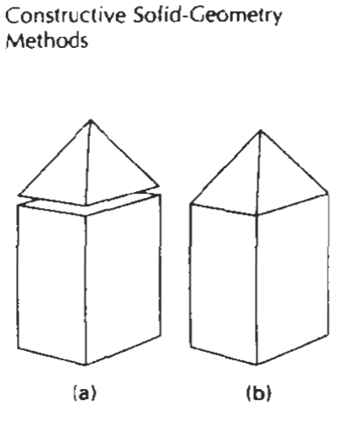
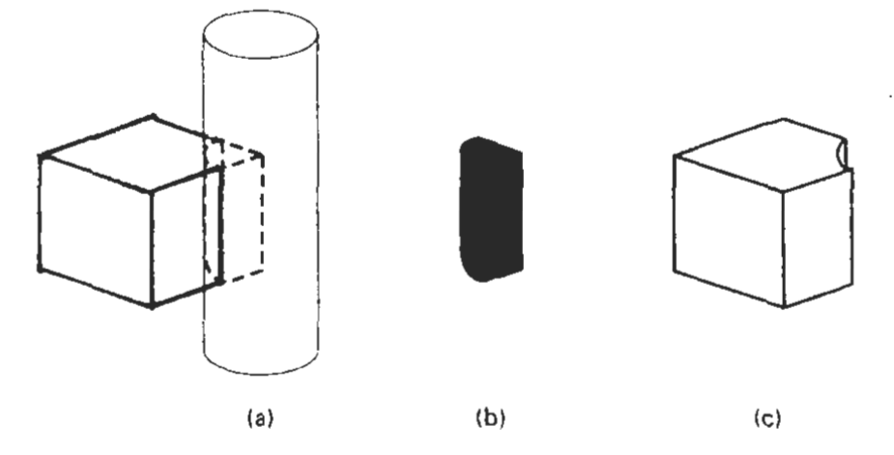
CONSTRUCTIVE SOLID-GEOMETRY METHODS
A CSG application starts with an initial set of three dimensional objects (primitives), such as blocks, pyramids, cylinders, cones, spheres, and closed spline surfaces
Figure a (photo 1) shows the block of pyramid are placed adjacent to each other...Fig b shows specifying the union operation, we obtain the combined object pyramid. Fig a (photo 2) shows a block and a cylinder with overlapping volumes.

Slide 24
FRACTAL
All the object representations …Euclidean-geometry methods;
that is, object shapes were described with equations.
These methods are adequate for describing manufactured objects:
Those that have smooth surfaces and regular shapes.
But natural objects, such as mountains and clouds, have irregular or fragmented features, and Euclidean methods do not realistically model these objects.
Natural objects can be realistically described with fractal-geometry methods, where procedures rather than equations are used to model objects.
A fractal is a never ending pattern. They are created by repeating a simple process over and over in an ongoing feedback loop. In graphics applications fractal representations are used to model terrain,clouds,water,trees and other plants.

Slide 25
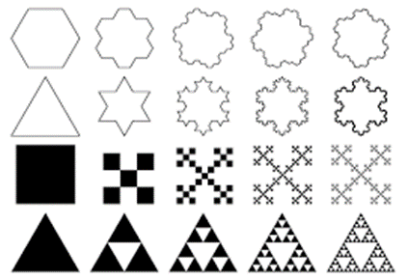
Fractal example

Slide 26
FRACTAL
A fractal object has two basic characteristics:
infinite detail at every point and
a certain self similarity between the object parts and the overall features of the object.
We can describe the amount of variation in the object detail with a number called the fractal dimension.
Unlike the Euclidean dimension, this number is not necessarily an integer. The fractal dimension of an object is sometimes referred to as the fractional dimension, which is the basis for the name "fractal“.

Slide 27

Fractal-Generation Procedures
A fractal object is generated by repeatedly applying a specified transformation function to points within a region of space.
If P₀ = (x₀, y₀,z₀) is a selected initial point, each iteration of a transformation function F generates successive levels of detail with the calculations
In general, the transformation function can be applied to a specified point set, or we could apply the transformation function to an initial set of primitives,
such as straight lines, curves, color areas, surfaces, and solid objects.

Slide 28
Classification of Fractals
Self similar
Self-affine
Invariant fractal sets
Self similar
Self similar fractals have parts that are scaled-down versions of the entire object.
Starting with an initial shape, we construct the object subparts by apply a scaling parameter to the overall shape.
If we apply random variations to the scaled-down subparts, the fractal is said to be statistically self similar. E.g commonly used to model trees, bushes, and other plants.

Slide 29
Classification of Fractals
Self-affine
Self-affine fractals have parts that are formed with different scaling parameters, s_{x} s_{y}, s_{z}, in different coordinate directions.
And we can also include random variations to obtain statistically self-affine fractals.
Terrain (land), water, and clouds are typically modeled with statistically self-affine fractal construction methods
Invariant fractal sets
Invariant fractal sets are formed with nonlinear transformations.
This class of fractals includes self-squaring fractals, such as the Mandelbrot set, which are formed with squaring functions in complex space; and self inverse fractals, formed with inversion procedures.

Slide 30
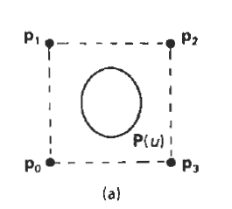
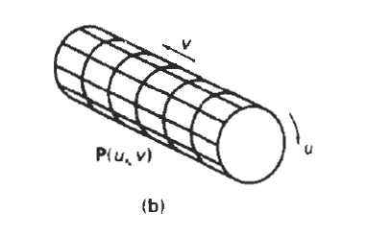
Sweep Representation
Sweeping an object along a trajectory through space defines a new object, called a sweep.
Sweep representations are useful for constructing three-dimensional objects that maintain translational, rotational, or other symmetries.
We can represent such objects by specifying a two dimensional shape and a sweep that moves the shape through a region of space.
A set of two-dimensional primitives, such as circles and rectangles, can be provided for sweep representations as menu options.
Other methods for obtaining two-dimensional figures include closed spline curve constructions and cross-sectional slices of solid objects.
A sweep can follow any path.

Slide 31
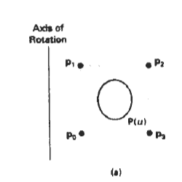
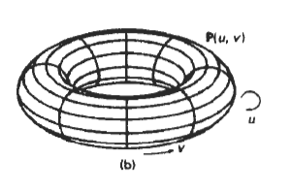
Sweep Representation
Constructing a solid with a rotational sweep Rotating the control points of the periodic spline curve in (a) about the given rotation axis generates the solid shown in (b), whose surface can be described with point function P(u,v).

Slide 32
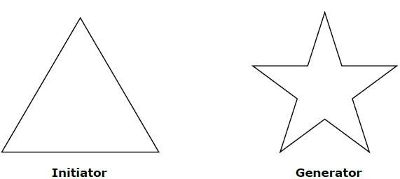
Describe geometric construction of deterministic self similar fractals.
Geometric fractals deal with shapes found in nature that have non-integer or fractal dimensions. To geometrically construct a deterministic (nonrandom) self-similar fractal, we start with a given geometric shape, called the initiator. Subparts of the initiator are then replaced with a pattern, called the generator.

Slide 33
As an example, if we use the initiator and generator shown in the above figure, we can construct good pattern by repeating it. Each straight-line segment in the initiator is replaced with four equal-length line segments at each step. The scaling factor is 1/3, so the fractal dimension is D = ln 4/ln 3 ≈ 1.2619.
Also, the length of each line segment in the initiator increases by a factor of 4/3 at each step, so that the length of the fractal curve tends to infinity as more detail is added to the curve as shown in the following figure −

Slide 34
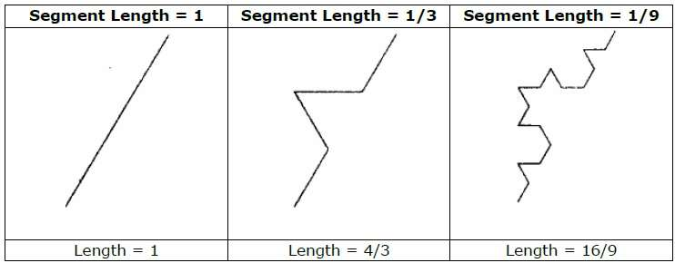

Slide 35
Characteristics Of Fractals
Infinite detail at every point
Self-similarity
Uniform distribution
Design simplification
Predictability
Infinitely variable in design
Shape with finite area
Iterative addition or subtraction elements

Slide 36
Applications Of Fractals
Classification of histopathology slides in medicine
Generation of new music
Generation of various art forms
Signal and image compression
Seismology
Cosmology
Computer and video game design, especially computer graphics for organic (অঙ্গীয়) environments
Fractography and fracture mechanics

Slide 37
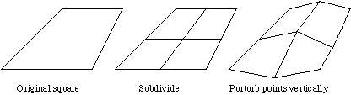
Explain the random midpoint displacement method for constructing fractals object
Random midpoint displacement is a recursive generating technique that was applied to normal Brownian motion.
To understand the algorithm of midpoint displacement method, first consider a square grid on the x-z plane. The algorithm can be summarized below:
1) split the square up into a 2*2 grid
2) vertically displace each of the 5 new vertices by a random amount in the y-direction
3)repeat this process for each of the new squares, decreasing the displacement for each iteration
Graphically, it can be conceptualized as follows:

Slide 38
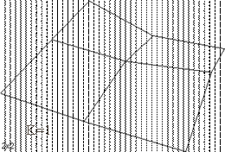
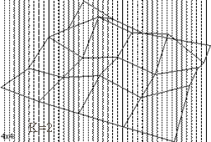
As the iterations grow, the landscape would evolve in the following manner:

Slide 39
1.PolyHedra and Euler’s formula?(SHIT)
2.What do you understand by spatial occupancy enumeration?(SHIT)
3.Octrees?(SHIT)
4.Quberillie ?(SHIT)
5.Explain how the dimension of a fractal can be defined? Book
6.Describe geometric construction of deterministic self similar fractals.
7.Charactesistics of fractals?
8.Explain the random midpoint displacement method for constructing fractals object.?
10.Self squiring fractal?(Book)

